Slide 1
PLACEMENT CELL

Slide 2
ABSTRACT
From a student’s perspective, placements can bring a wide range of benefits and opportunities. Training and management of placement is a crucial part of an educational institution in which most of the work is done manually. Manual system in the colleges requires a lot of manpower and time. With this project we aim to develop a web portal to solve this issue. The project is aimed at developing an application for the placement department of the college. The system is an application which will be accessed and effectively used throughout the organization with proper login enabled. It can also be used as an application for the Placement Officers in the college to manage the student information about placement thus reducing the manual work and consumes less paperwork. The system also provides the facility of viewing the personal and academic information of the student. The system gets the requested list of candidates for the companies who would like to recruit the people according to their eligibility criteria. Laravel framework is used to facilitate the process of making the program.

Slide 3
OBJECTIVE
To assist student to develop / clarify their academic and carrier interest,and their short and long term goals through individual counseling and group session.

Slide 4
HARDWARE SPECFICATION
Processor : P 4 700 GHz.
RAM : 4 GB RAM
Hard Disk Drive : 180 GB

Slide 5
SOFTWARE SPECIFICATION
Operating System : Windows 7/8/10
Front End : JAVA
Back End : SQL

Slide 6
EXISTING SYSTEM
In colleges the records were stored in excel sheets hence sorting the data is always a problem. The excel sheets are also less advanced. Hence sorting and searching problems arises. Updating Records is another tedious task. Due to the above problems the updating was very difficult and ambiguous. Data redundancy also occurs due to the duplication of files and records. The files were not stored in a hierarchical format, hence searching the eligible students was the greatest problem [1]. The placement officer has to find out the eligible students by looking at the excel sheet. He/she has to see the marks of every student and their eligibility
DISADVANTAGES
students face is that they are not made aware of the Training and Placement activity held in their institutions, hence there might have been a loss of opportunities
Hence lots of confusion at the last moment also arises

Slide 7
PROPOSED SYSTEM
To design and implement a web-based placement management system. High-quality placements bring good benefits and positive impacts on students as well as for the colleges. During this process college finds it difficult and time-consuming to collect data from each student. In most cases they collect data manually. Working in a manual system in the colleges requires a lot of manpower and time. The placement management system is an online application that can be accessed throughout the college and outside with proper login details. This system can be used as an application for the placement officer, Hod, faculty coordinator of the college to manage the student information with regards to placement. The student is able to upload their information
ADVANTAGES
Can track the student details
Easy to apply the job systematically

Slide 8
Modules
Admin Module
The Placement officer is the administrator of the system. Admin plays a very crucial role in the system. Admin can log in through a username and password. He/she can maintain the placement activities via the system. Admin can add departments, create new batches, add /delete drives. Students can directly join in the placement drive if interested. Admin can manage the training programs conducted in the college. Admin is also able to analyze the placement activities of each student.
2. Student Module
Every student is given a default username and password, using this he/she can enter the system. Students can fill the necessary details like 10 th grade etc. if interested, students can register for the upcoming drives. The student is also able to attend the online aptitude test being conducted in the system. Based on this aptitude test and other criteria the placement probabilities of a particular student are been predicted

Slide 9
3. Placement Company Details
Admin logged in to the portal and register the company details. Before registering the details, they should login and enter these details because of the security reason. What ever the placement company details are entering which will be shown in the student screen then only they can applied the company.
4. Apply Company
Once the company details are entered then student can apply the job opportunity. In this module has displayed some details about the interview and the interview process, interview date and etc. it will be notify by the admin once its apply
5.Student Applies Details
When the students are applied the job portal the notification will be sent to the admin/teacher. Then the teacher can be verifying the student details and share their resume to the company.

Slide 10

Data Flow Diagram
Level 0

Slide 11
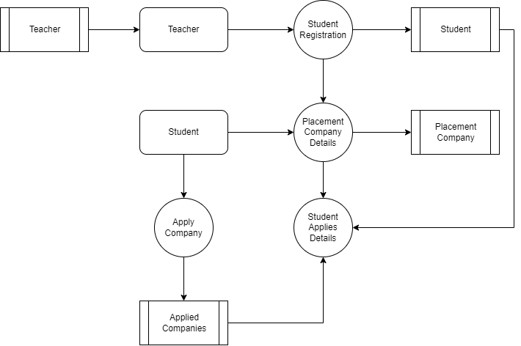
Level 1:

Slide 12
TABLE DESIGN TABLE NAME:ADMIN
FIELD | DATA TYPE | SIZE | CONSTRAINT
Admin id | Int | 10 | Primary key
Username | Varchar | 30 | Not null
password | Varchar | 30 | Not null

Slide 13
TABLE NAME:Company
FIELD | DATA TYPE | SIZE | CONSTRAINT
Company id | Int | 10 | Primary key
Company Name | Varchar | 30 | Not null
Branch | Varchar | 20 | Not null
Url | Varchar | 10 | Not null

Slide 14
TABLE NAME:Drive
FIELD | DATA TYPE | SIZE | CONSTRAINT
Drive id | Int | 10 | Primary key
Title | Varchar | 20 | Not null
Company Id | int | 10 | Foreign Key
job position | Varchar | 30 | Not null
profile | Varchar | 20 | Not null
Date | Date | 10 | Not null
Salary | Int | 5 | Not null
sslc | int | 3 | Not null
hsc | int | 3 | Not null
graduation | int | 3 | Not null

Slide 15
TABLE NAME:Student
FIELD | DATA TYPE | SIZE | CONSTRAINT
Student id | Int | 10 | Primary key
username | Varchar | 20 | Not null
user email | Varchar | 20 | Not null
password | Varchar | 30 | Not null

Slide 16
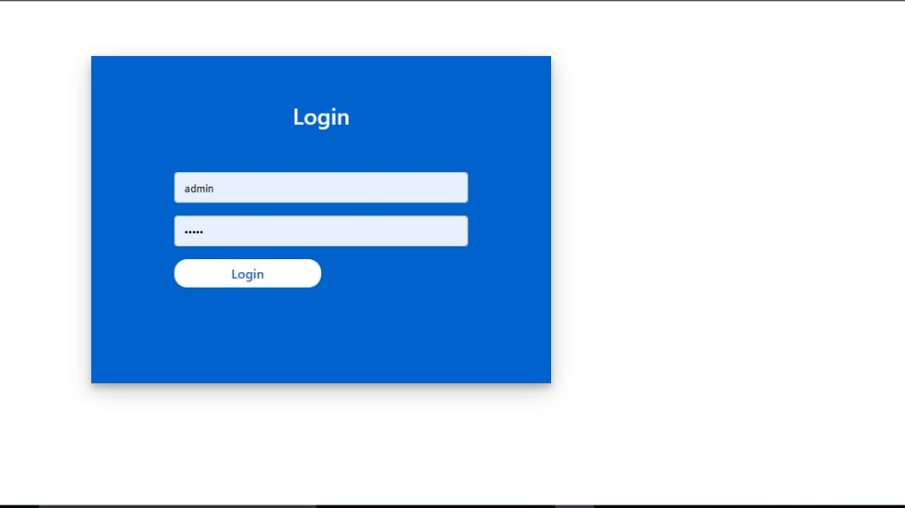

Slide 17
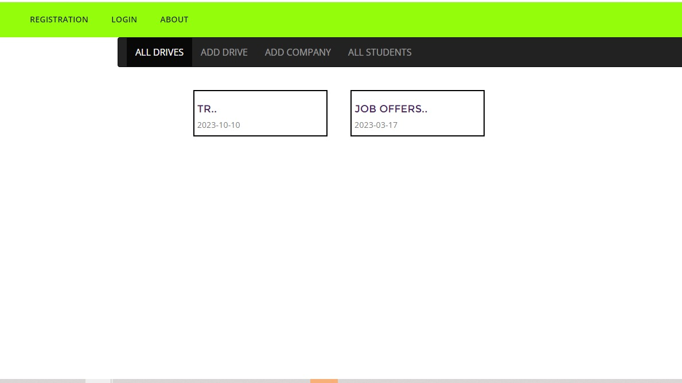

Slide 18
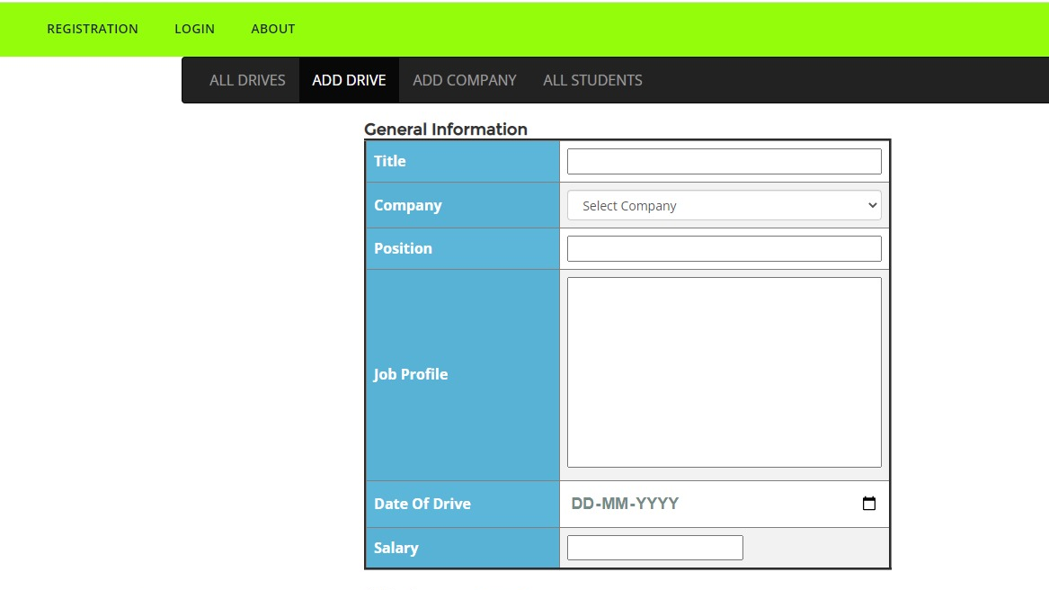

Slide 19
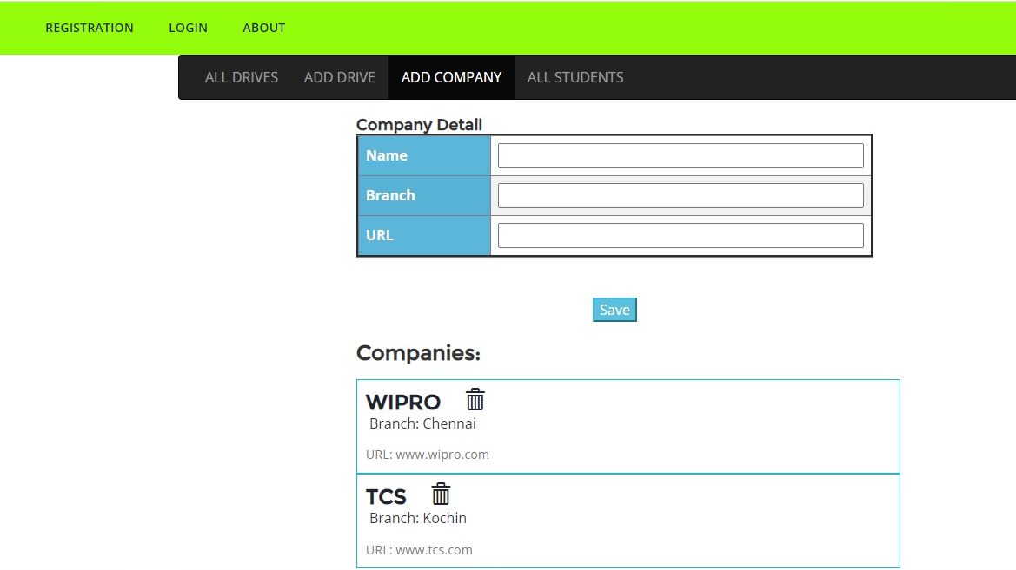

Slide 20
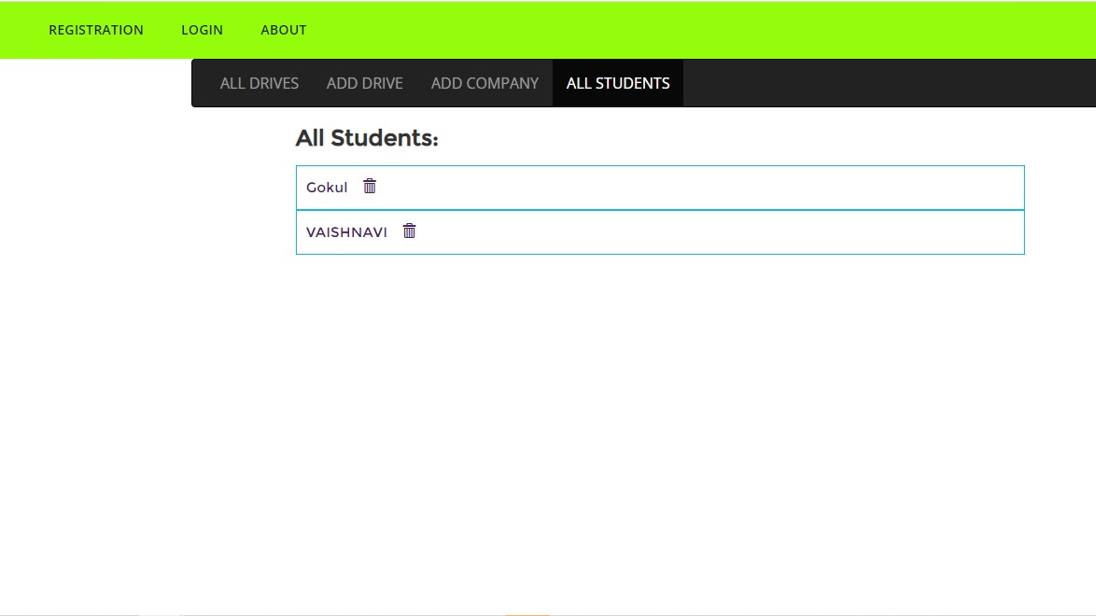

Slide 21
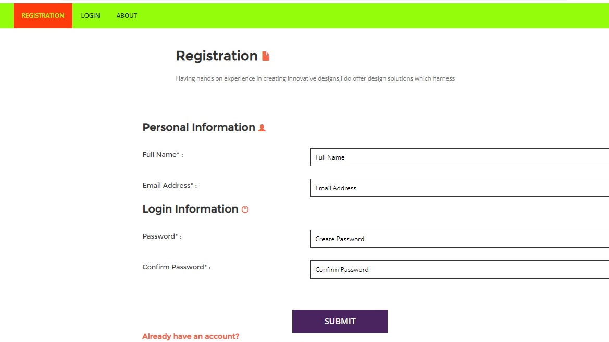

Slide 22
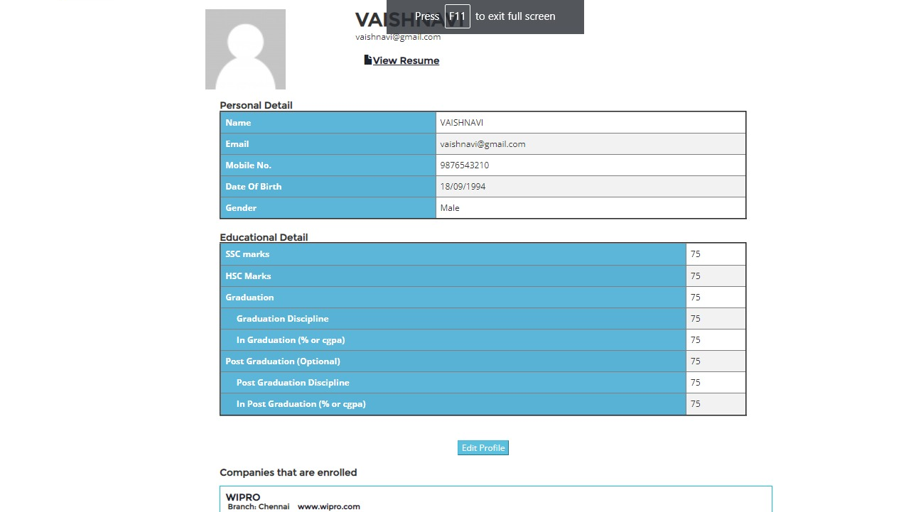

Slide 23
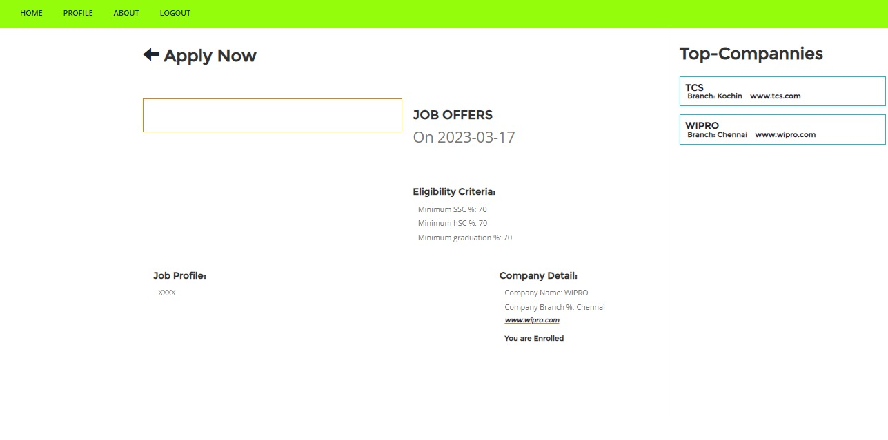

Slide 24
Thank You

